Slide 1
The Corona Kreep

Slide 2
The corona kreep
Theme
Stats
Coding Approach
Data Munging
Visualizations
Lessons Learned
Questions

Slide 3
The corona kreep
Theme
What is Covid-19 (A.K.A. the Corona Virus)?
Focus on number of Corona cases
Confirmed Cases
Number of Deaths
Recovered
Active Cases

Slide 4
The corona kreep What is the Coronavirus?
Coronavirus disease 2019 (COVID-19) is a respiratory illness that can spread from person to person. The virus that causes COVID-19 is a novel coronavirus that was first identified during an investigation into an outbreak in Wuhan, China.

Slide 5
Confirmed cases Worldwide
As of 4/1/2020
There are 986,310 confirmed cases

Slide 6
Confirmed cases in the U.S.
In the U.S. alone,
There are 228,674 confirmed cases.
This is almost twice as Italy and close to three times the number “reported” from China

Slide 7
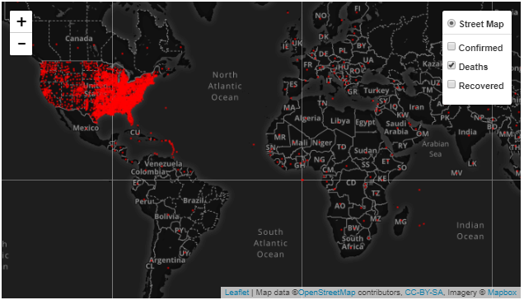
Worldwide Deaths
As of 4/1/2020
50,395 people have died from covid-19 5.11% of confirmed cases

Slide 8
Deaths in the U.S.
In the U.S. alone,
5,369 people have died from this virus. This equates to a 2.34% mortality rate

Slide 9
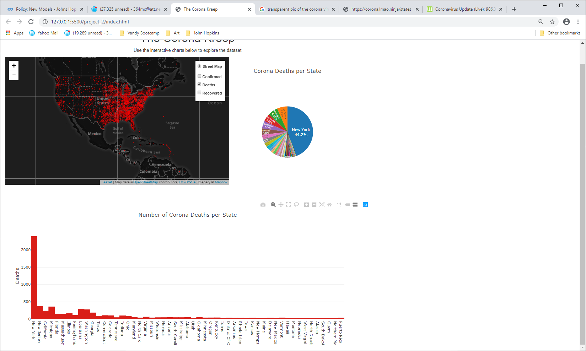

Deaths in the U.S.
The number of deaths caused by this virus are concentrated in high populated cities

Slide 10
recoveries Worldwide
As of 4/1/2020
206,372 have recovered from the virus, or 21%
Sadly, 729543 are still battling covid-19

Slide 11
Recoveries in the U.S.
As of 4/1/2020
10,280 have recovered from the virus, or 4.5%.
Sadly, 213,025 are still battling covid-19

Slide 12
Active Cases
Class | Worldwide | U.S.
Active | 729,543 | 213,025
Mild Condition | 692,514 / 95% | 207,604 / 97.5%
Critical Condition | 37,029 / 5% | 5,421 / 2.5%
https://www.worldometers.info/coronavirus/#countries

Slide 13
Coding Approach
Our group worked well as a team.
We each played a role in developing parts of each visualization, the index page, and supporting code.
We sought help when needed and collaborated well throughout the process.

Slide 14
Data Munging
We did not have to manipulate the data as we chose a clean data set.
We did start with one data set to focus on the US data but it did not have coordinates so we chose a different one.
We used an API to capture up to date stats.

Slide 15
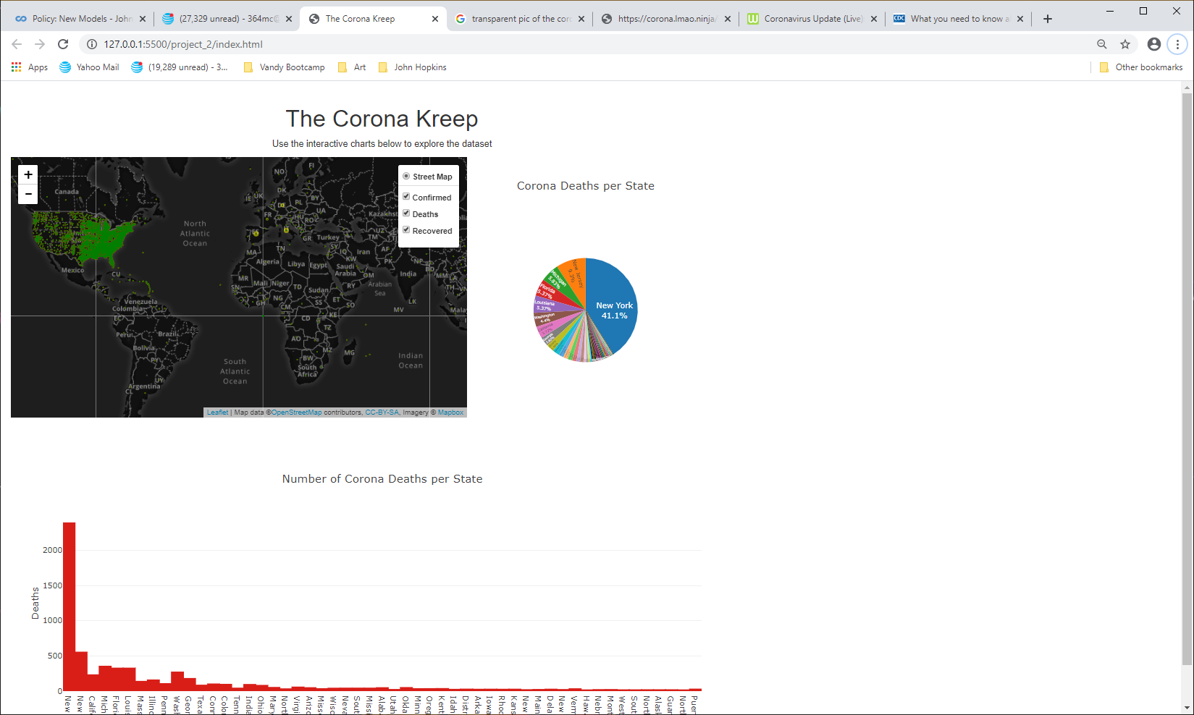
Visualizations
Our visualizations consisted of an interactive map focusing on global data; a pie chart and a bar graph focusing on US data.

Slide 16
Lessons learned
The actual confirmed cases, deaths, and recoveries my not be an accurate account as some data has yet to be recorded / reported.
Data points on the map do not explain the dispersal of cases in countries other than the U.S..
One coordinate was given for each country where as one coordinate was given for each U.S. city.
There are many datasets out there and we chose a data set stating only the facts at the time of capture.

Slide 17
Questions?

Slide 18
Fin Thank you!

